Slide 1

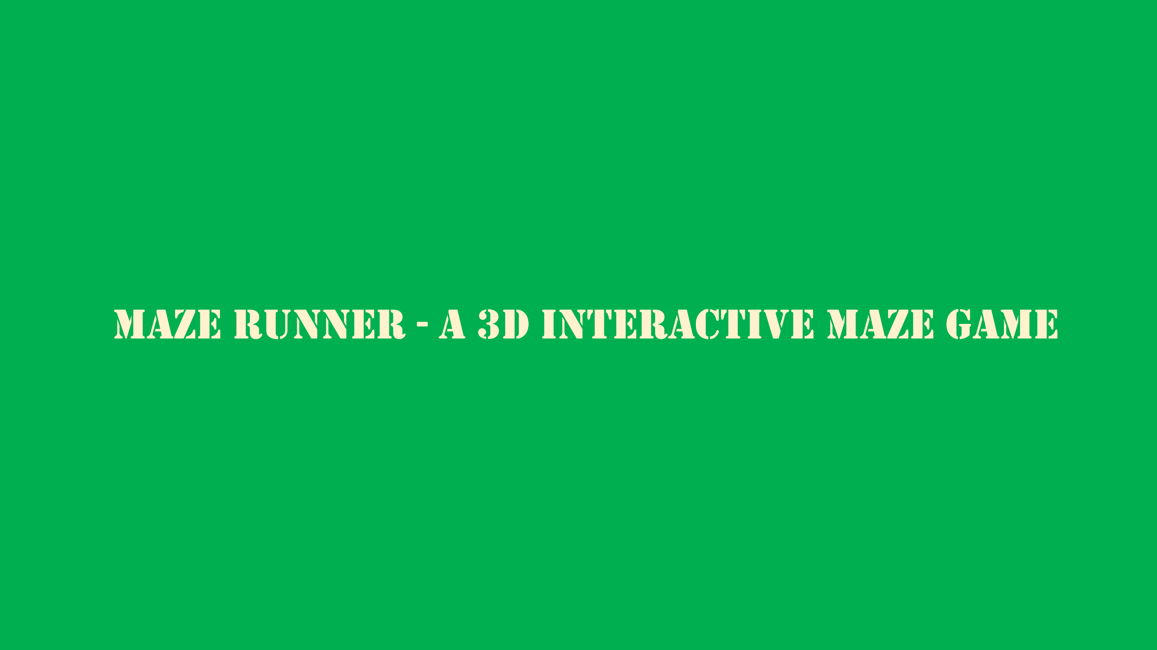
Maze Runner - A 3D Interactive Maze Game Three.js (WebGL)
Maze Runner is a simple 3D maze game.
The player navigates through a maze.
Objective:
Collect all coins
Reach the exit
The game focuses on core 3D graphics concepts.

Slide 2

Graphics & Technical Implementation
Maze Runner - A 3D Interactive Maze Game Three.js (WebGL)
Maze Runner is a simple 3D maze game.
The player navigates through a maze.
Objective:
Collect all coins
Reach the exit
The game focuses on core 3D graphics concepts.
Game Objective & Rules
Technologies Used
Camera Techniques
Game Logic Flow

Slide 3
Maze Runner - A 3D Interactive Maze Game Three.js (WebGL)
Graphics & Technical Implementation
Game Objective & Rules
Technologies Used
Maze Runner is a simple 3D maze game.
The player navigates through a maze.
Objective:
Collect all coins
Reach the exit
The game focuses on core 3D graphics concepts.
Camera Techniques
Game Logic Flow

Slide 4
Graphics & Technical Implementation
Game Objective & Rules
Objective:
Collect all coins.
Reach the exit to win.
Controls:
Move: W / A / S / D
Arrow keys
Camera:
Mouse movement
Restart:
Restart button after winning
Technologies Used
Camera Techniques
Game Logic Flow

Slide 5
Graphics & Technical Implementation
Game Objective & Rules
Technologies:
HTML5
JavaScript
Three.js (WebGL)
Why Three.js?
Easy WebGL abstraction
Real-time 3D rendering
Good camera and lighting support
Technologies Used
Camera Techniques
Game Logic Flow

Slide 6
Graphics & Technical Implementation
Game Objective & Rules
Camera System:
Third-person camera
Camera follows the player
Mouse controls camera rotation
Transformations:
Rotation using yaw & pitch
Camera offset relative to player
Technologies Used
Camera Techniques
Game Logic Flow

Slide 7
Graphics & Technical Implementation
Player moves inside maze
Collides with walls
Collects coins
Timer increases
Player reaches exit
Timer stops
Win screen appears
Game Objective & Rules
Technologies Used
Camera Techniques
Game Logic Flow

Slide 8
Maze Runner

Slide 9
Maze Runner

Slide 10
Maze Runner
Scene & Rendering
Scene Setup:
Perspective Camera
WebGL Renderer
Scene background color
Rendering Loop:
requestAnimationFrame()
Real-time updates for:
Player movement
Camera tracking
Animations

Slide 11
Lighting Techniques
Lighting Used:
Ambient Light
Directional Light
Purpose:
Ambient Light: basic visibility
Directional Light: shadows and depth
Enhances 3D realism

Slide 12
Sound Effects
Audio Features:
Background music
Sound effects (coin collection, win)
Purpose:
Improve immersion
Feedback for actions

Slide 13
Graphics Objects
Game Objects
Player (Box geometry)
Walls (Box geometry)
Coins (Cylinder geometry)
Exit (Emissive cube)
Transformations Used
Translation
Rotation
Scaling

Slide 14
Collision Detection
Collision System
Bounding boxes (THREE.Box3)
Player vs walls
Player vs coins
Player vs exit
Purpose
Prevent walking through walls
Detect coin collection
Detect win condition

Slide 15
Challenges Faced
Solution
Animation & Interaction
Animations
Rotating coins
Smooth player movement
Smooth camera motion
Interaction
Keyboard input
Mouse input
Real-time HUD updates
Collision accuracy
Camera synchronization
Keyboard input handling
Game state management
Bounding box collision
Separate movement logic
Centralized game loop

Slide 16
Conclusion
Challenges Faced
Solution
What We Learned:
WebGL basics
3D transformations
Game loop design
Future Improvements:
More levels
Enemies
Better textures
Advanced shaders
Collision accuracy
Camera synchronization
Keyboard input handling
Game state management
Bounding box collision
Separate movement logic
Centralized game loop

Slide 17
Challenges Faced
Solution
Conclusion
What We Learned:
WebGL basics
3D transformations
Game loop design
Future Improvements:
More levels
Enemies
Better textures
Advanced shaders
Collision accuracy
Camera synchronization
Keyboard input handling
Game state management
Bounding box collision
Separate movement logic
Centralized game loop

Slide 18

Conclusion
THANKS
for your attention.
What We Learned:
WebGL basics
3D transformations
Game loop design
Future Improvements:
More levels
Enemies
Better textures
Advanced shaders

